Slide 1
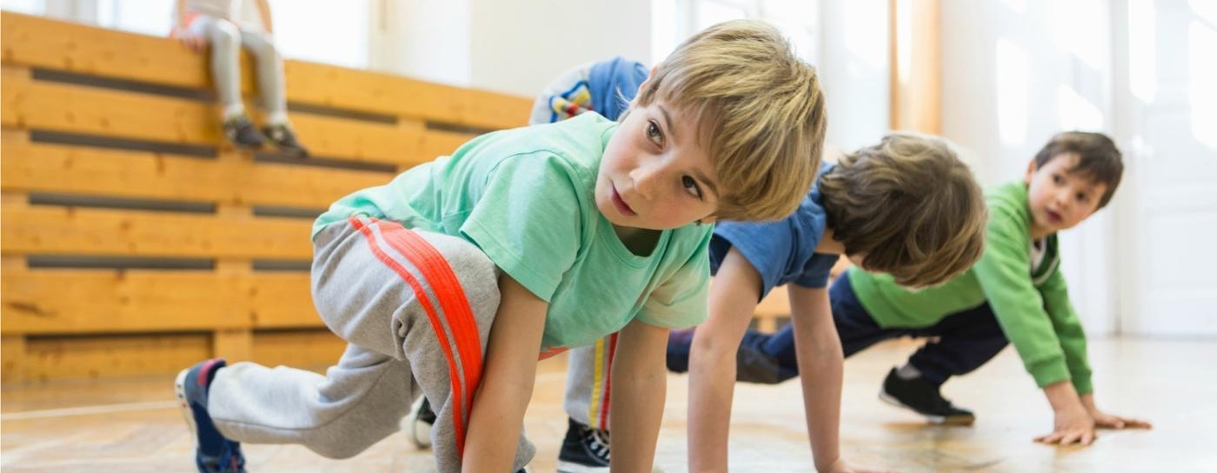
Sixty Active Minutes for Every Child, Every Day
Providing 30 active minutes in school
Influencing 30 active minutes beyond school
Notes:
Course description:
The local engagement event will support schools to increase physical activity throughout the school day to boost health and academic achievement for their students. It looks at how schools can:
meet the requirements of the government’s childhood obesity plan
develop their understanding of the evidence and research underpinning active approaches in schools
learn how to use the free Active School Planner to increase daily activity and reduce sitting time for every child
explore solutions to boost wellbeing and achievement by building 30 active minutes of physical activity into the whole school day and influencing 30 active minutes beyond the school day.
Outcomes:
By the end of the workshop, delegates should be able to:
advocate why high levels of physical activity across the school day lead to healthier and more effective learners
reflect on how effective their current provision is at promoting physical activity throughout the school day
know how to reduce sedentary behaviour and embed physical activity in their school
plan their journey to becoming an Active School

Slide 2
The Challenge;
Our children and young people are not active enough.
Notes:
The challenge, as presented by the Childhood Obesity Plan for Action

Slide 3
30.1%*
22.7%*
47.2%*
Now 2.2 million*
*Active Lives Data 2022

Slide 4
The Consequence;
Nearly a third of children aged 2 to 15 are overweight or obese.
22.7% of year 6 children are obese (NCMP, 2022).
Notes:
The challenge, as presented by the Childhood Obesity Plan for Action

Slide 5
National Child Measurement Programme,
England 2022/23 School Year

Slide 6
National Child Measurement Programme,
England 2022/23 School Year

Slide 7
Obesity doubles the risk of dying prematurely.

Slide 8
Other challenges and consequences include related to inactivity;
Notes:
The challenge, as presented by the Childhood Obesity Plan for Action

Slide 9
Available at www.activeschoolplanner.org
Notes:
The challenge, as presented by the Childhood Obesity Plan for Action

Slide 10
Poor mental wellbeing
18% of children aged 7 to 16 have a probable mental disorder. This increases to 20% for those aged 11-16 (NHS Digital, 2022)
The number of under 18s referred to Child and Adolescent Mental Health Services (CAMHS) has risen by 53% since 2019, escalating to over 1.2 million in 2022, according to data from NHS Digital1 analysed by the mental health charity, YoungMinds.
The number of children in England needing treatment for mental health problems has risen 39% in a year (PA Media, 2022).
Lonely and disconnected
Most parents (79%) believe that children are spending too much time online and not enough time with each other (Youth Sport Trust, YouGov, 2022)
1000 Voices – 16 of the 18 activities 11-24 year olds like doing in spare time are sedentary. Most are alone.
In 2022, 5.2% of children aged 11-16 years said they often or always felt lonely, this was more than double (12.6%) for those young people aged 17-22 years (NHS Digital, 2022).

Slide 11
Increased inequality
Young people from low affluence families are less likely to be active compared to those from medium and high affluence families (Sport England, 2022)
Over a fifth of young people from poorer backgrounds (21%) think their life will amount to nothing, no matter how hard they try (Princes Trust, 2022).

Slide 12
National Child Measurement Programme,
England 2020/21 School Year
https://www.gov.uk/government/statistics/national-child-measurement-programme-england-202021-school-year

Slide 13
Issues in schools
The number of PE teachers in England reduced by 8.8% between 2011 and 2021 (Gov UK, 2022)
91% of teachers report that their job has adversely affected their mental health in the last 12 months (NASUWT, 2022)
Whilst we’ve seen small increases in PE hours in the last two years, PE hours are still significantly lower than 10 years ago – a reduction of 11% from 326,277 to 290,033 since 2011. This reduction is mainly driven by a reduction in PE hours for KS4 – down 20% in the last 10 years (Department for Education and Office for National Statistics, 2022).
Behaviour worse, attendance worse especially in secondary schools.

Slide 15
NATIONAL DATA
84%
67%
64%
60%
41%
15%
31%
28%
35%
45%
2%
2%
8%
5%
15%
66%
56%
13%
24%
21%
20%
*More or less than 100% due to rounding

Slide 16
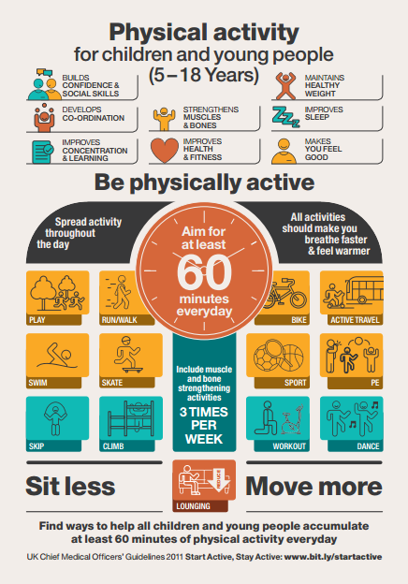
The Role of Schools;
Every child should get at least 60 minutes of moderate to vigorous physical activity a day.
At least 30 minutes should be delivered in school every day.
www.gov.uk/government/uploads/system/uploads/attachment_data/file/541231/CYP_infographic.pdf
Notes:
CMO recommendations

Slide 17
Sports Premium doubled to address 60 Active minutes
An average sized primary school has received £149,360 in the last 10 years (March 13-23).
www.gov.uk/government/publications/childhood-obesity-a-plan-for-action
Notes:
We’ve seen the challenge to individuals and society as a whole. What resources, support and accountability measures will be provided to support schools in helping to address the obesity epidemic?

Slide 18
https://www.gov.uk/guidance/pe-and-sport-premium-for-primary-schools
About the PE and sport premium
“Schools have a central role to play in supporting all children and young people to live healthy active lives. This is particularly true of primary school where the foundations of positive and enjoyable participation in regular physical activity should be established”.
“Crucial to achieving this is ensuring that pupils have access to at least 30 minutes of physical activity during the school day, alongside high-quality PE provision taught by confident and knowledgeable teachers and opportunities to experience and participate in a wide range of sports and physical activities. PE and sport premium grant funding should be used by schools towards these aims”.

Slide 19
https://www.gov.uk/guidance/pe-and-sport-premium-for-primary-schools
Accountability
You are accountable for how you use the PE and sport premium funding allocated to you. The funding must be spent for the purpose it was provided – to make additional and sustainable improvements to the PE, sport and physical activity offered.
As part of their role, governors and academy trustees should monitor:
how the funding is being spent
how it fits into school improvement plans
the impact it is having on pupils
Schools and local authorities must follow the terms set out in the conditions of grant. If a local authority or a school fails to comply with these terms, the Secretary of State may require the repayment of the whole or any part of the premium paid to the local authority or school.

Slide 20
Monitoring the Impact;
Ofsted assess how school leaders use the Primary PE and Sport Premium and its impact.
Ofsted will conduct a thematic review on obesity, healthy eating and physical activity, with examples of good practice and recommendations on what more schools can do.

Slide 21
The power of an active school. Dr William Bird
Link to video on Agilitas website.
Link to video on YouTube.

Slide 22
Benefits to a more active school
Available at www.activeschoolplanner.org

Slide 23
Benefits to a more active school
Available at www.activeschoolplanner.org

Slide 25
The Evidence: A Rapid Summary.
www.gov.uk/government/publications/the-link-between-pupil-health-and-wellbeing-and-attainment

Slide 26
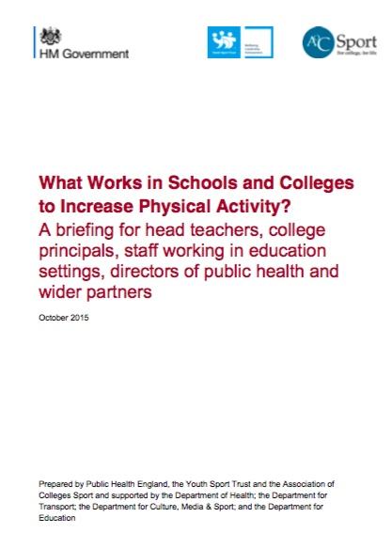
www.gov.uk/government/publications/what-works-in-schools-to-increase-physical-activity-briefing
www.designedtomove.org

Slide 27
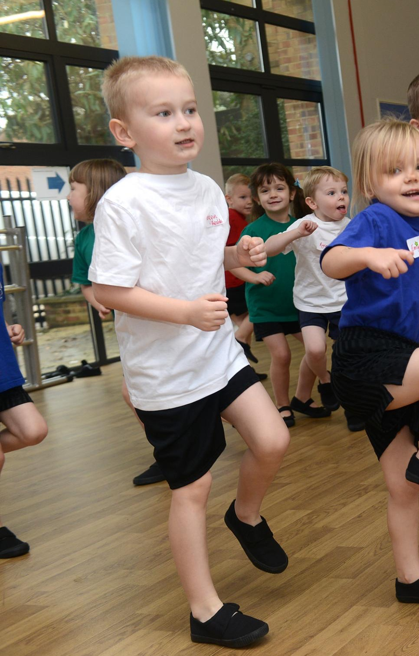
Task One
How well is your school already addressing challenge?
How many of your pupils achieve 60 minutes?

Slide 28
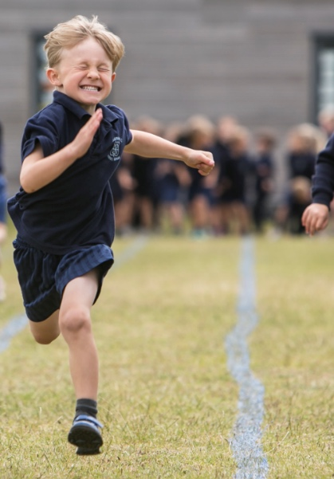
Task Two
How well prepared is your school to demonstrate the impact on health outcomes of primary sport funding?
What else do you need to do?

Slide 29
Resources available to help build a more active school;
Active School Planner.
Active Recovery Hub.
Other resource banks.

Slide 30
Building a more active school;
www.activeschoolplanner.org
Notes:
www.activeschoolplanner.org

Slide 31
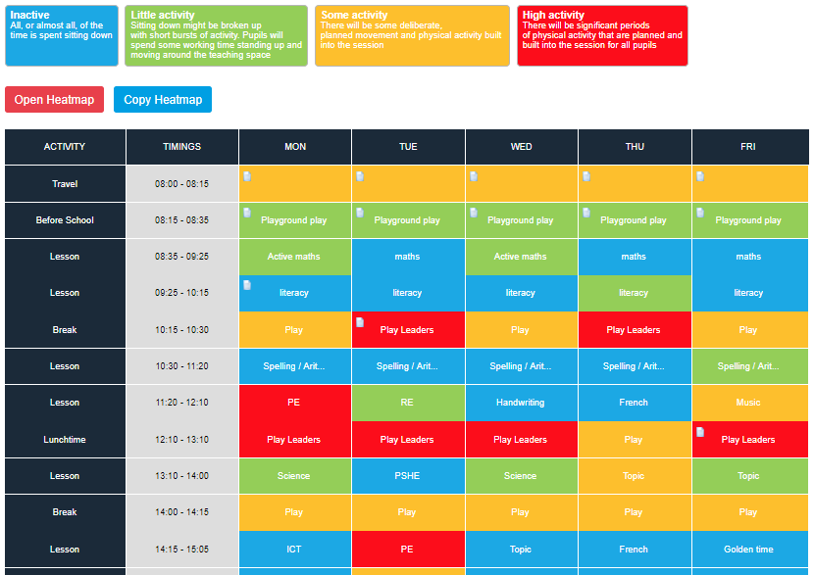
www.activeschoolplanner.org
#YSTActiveSchool
Notes:
The principle tool of the site is the activity heatmap. This is the self-review tool to help schools map current activity levels, plot the colder areas and begin to plan ways to increase activity levels at times in the school timetable. Further detail on the activity heatmap tool:
A school/user will need to modify the heatmap template when they first use the site to ensure it reflects the school timetable
Future heatmaps can then be copied to save the user having to repeat this process. However, they can start from scratch if required
Users reflect on practice and plot activity levels based on the scale specified. If the activity level is the same for a period all week, then the user can select ‘apply to all days’
Users can upload evidence/files/ images etc to periods of the school timetable. Evidence can be shared publicly and it will show in the Physical Activities Library
The most recent heatmap completed by the user will always show first
Once a heatmap is completed click ‘finish heatmap’

Slide 32
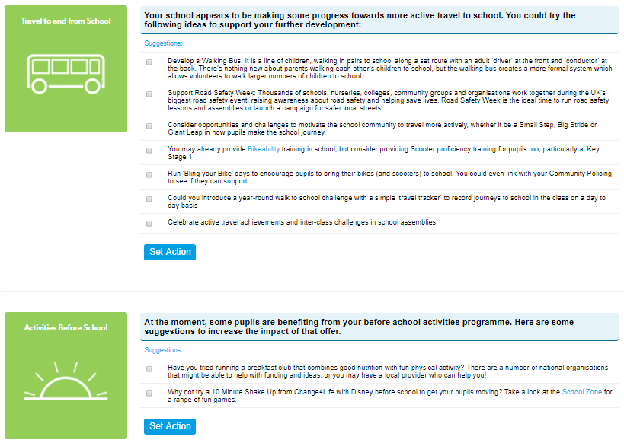
Action Planning
www.activeschoolplanner.org
Notes:
Action Planning
After finishing a heatmap the user is automatically taken to the Action Planning section to identify actions they will work through to increase activity and reduce sitting time.
Some suggested actions are generated by the website, based on the self-review completed by the user, however they can to select as many of these as they like. Users can also add their own actions.
Deadlines can be added for each action by the user and these will then be visible on the users dashboard. Users can then select each action as complete once it is done.
Once a user has finished, they can save their plan, or save as pdf to create a summary of the heatmap and action plan.

Slide 33
Notes:
Downloadable from the:
Physical Activities Library – Active School Planner

Slide 34
Building a more active school;
479
https://www.youthsporttrust.org/resources/coronavirus-support/active-recovery-hub
Notes:
Task 4

Slide 35
Building a more active school;
https://www.youthsporttrust.org/resources/coronavirus-support/active-recovery-hub
Notes:
Task 4

Slide 36
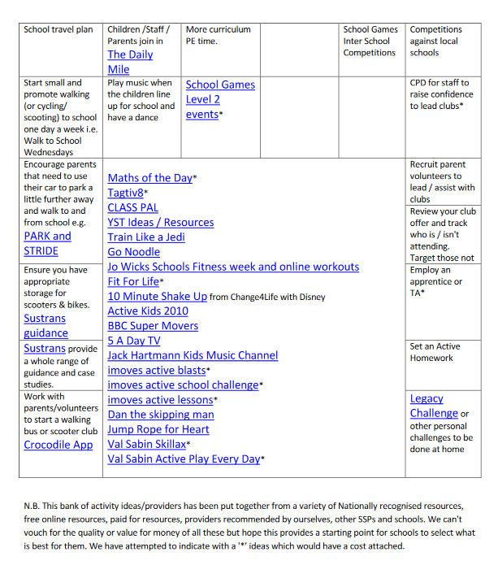
Building a more active school. Other resources;
https://www.agilitassports.com/active-30-30
Notes:
Task 4

Slide 37
Task Three;
What are you currently doing to increase activity during the 6 areas of the day?
Notes:
Task 4

Slide 38
The Active 30:30 rationale
6 activity opportunities across the day;
Health & cognitive benefits start to be realised
Active School
Travel
Before School
Classrooms
Break Times
Lunch times
.
After School
Sedentary Behaviour
Light activity
Moderate Activity
Vigorous Activity
Sleep
Sedentary physiology
Exercise physiology
Notes:
This is a start of a journey for schools!
To achieve the ambitions we need to create an active school culture which integrates and embeds movement throughout the school day – there is NOT an ambition to bolt on physical activity or find additional time in the school timetable. This will mean considering and ‘nudging’ children into standing up more (to avoid sitting time) and increasing their activity levels throughout the day (even if it’s light activity). This way we will start to influence the activity patterns of ALL children, and including those with the greatest health needs.
What we know is there are immediate benefits to reducing inactivity to our general health and to a child’s brain function.
It will require schools to think differently about their offer across the whole day so that they can demonstrate it does engage all children in 30 minutes a day

Slide 39
Task Four - Option A;
You’ve booked a 10 minute meeting with your Headteacher to talk about pupil activity and 60 active minutes.
What are the key points you’ll want to get across?

Slide 40
Task Four - Option B;
Your Headteacher wants you to make a ten minute presentation at the next staff meeting on the benefits of becoming a more active school, as some staff have expressed concerns that more activity in lessons might lead to slower progress in English and Mathematics.

Slide 41
Task Four cont.
Outline the key points of your presentation.
What are you going to say to them?
What materials would you like to refer to (publications, websites, videos etc)?

Slide 42
Next Steps;
Look at the resources available?
Check you know who is and isn’t active?
Make a plan to talk to your Headteacher?
What are the key issues for your school?
What additional support do you need?

Slide 43
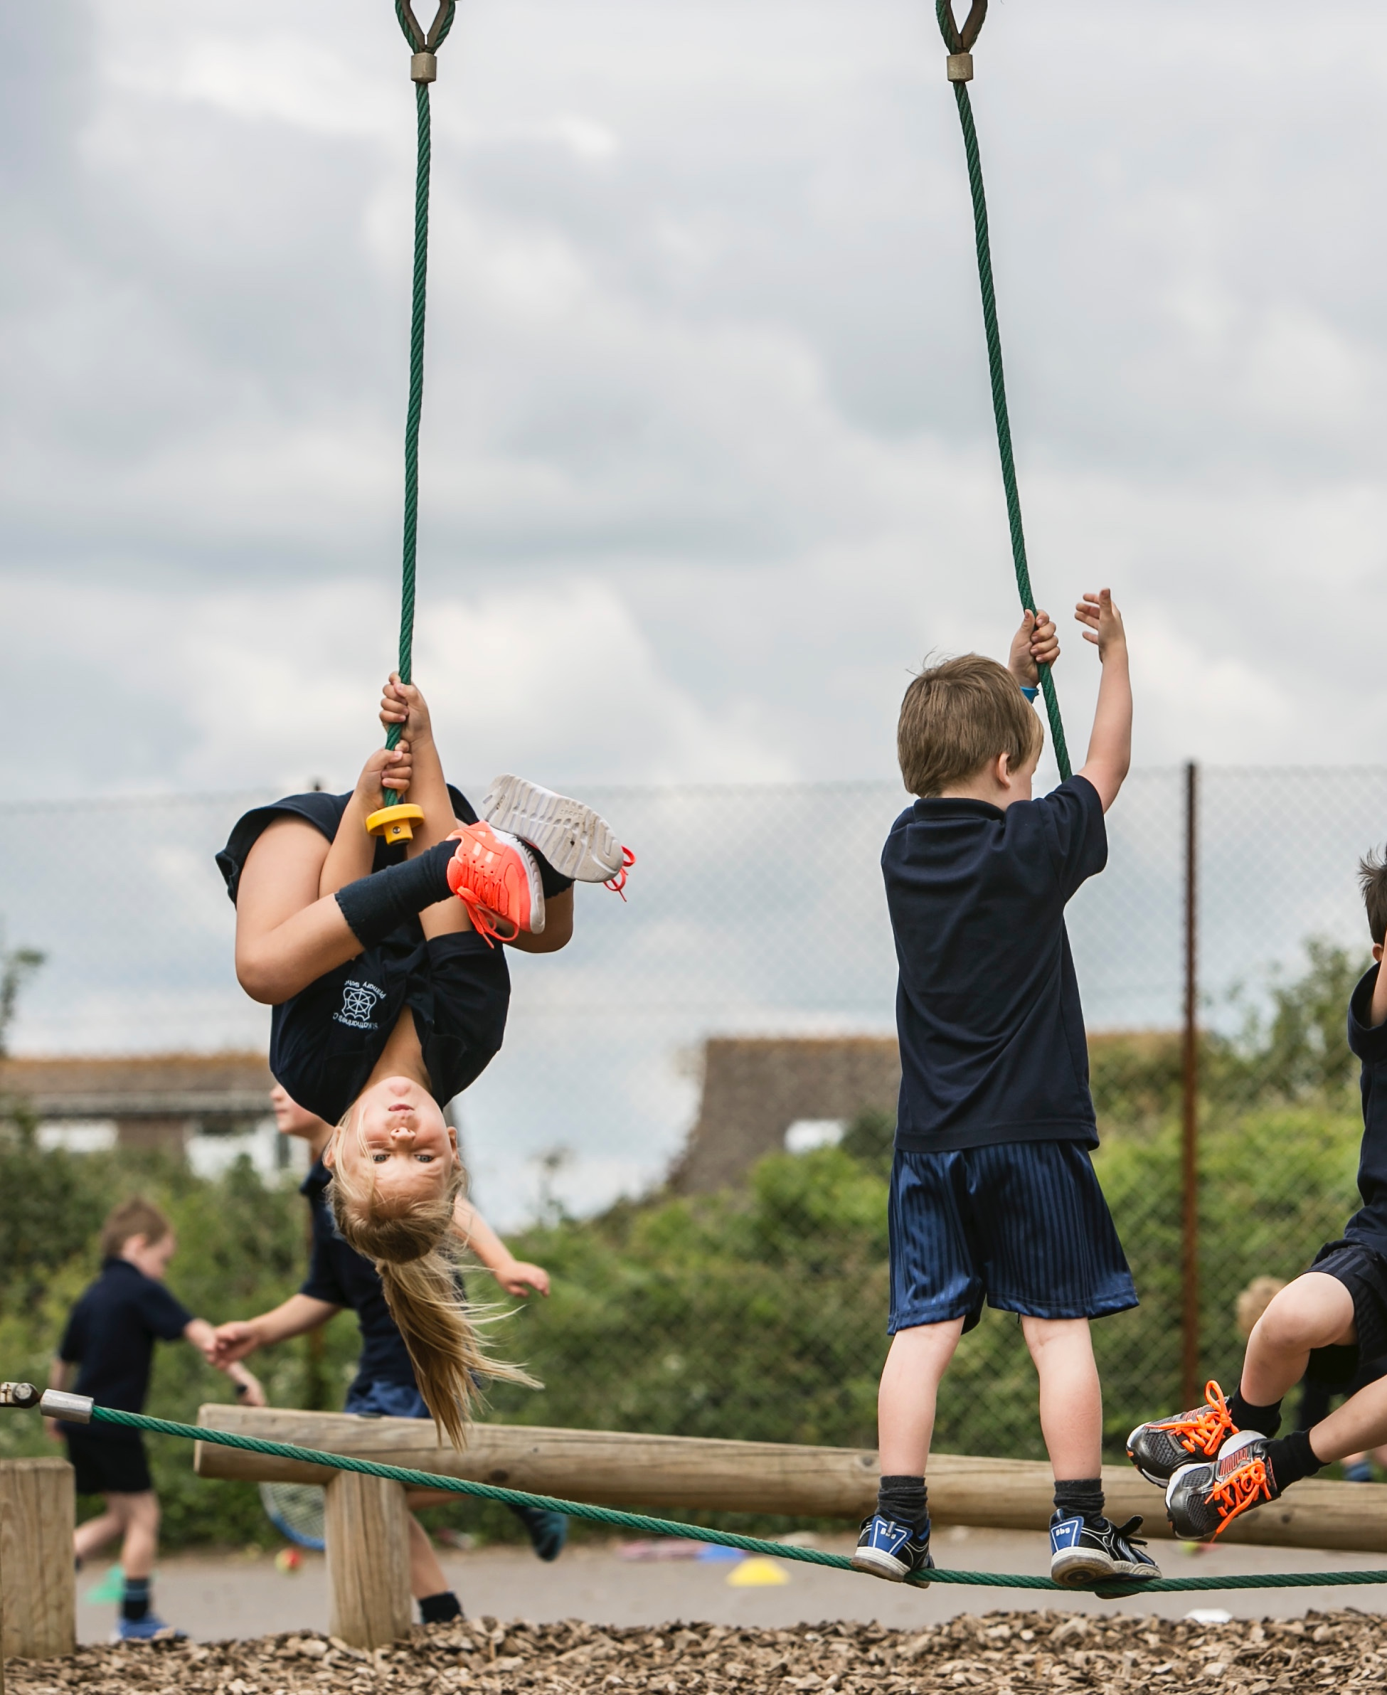
Thank you and good luck.

