Slide 1
#LincsSchoolsStandUp

Slide 2
#LincsSchoolsStandUp
Problem

Slide 3
#LincsSchoolsStandUp
Inactive lifestyles.
Only 21% of boys and 16% of girls meet the minimum recommended guidelines for physical activity.
Children today are on course to be 35% less active than those in 1961.
The average 12 year old spends 260 minutes of their time sedentary (sitting) whilst at school.
By the age of 15 this increases to 295 minutes.
UK is the 3rd ‘laziest’ country in Europe (The Lancet July 18 2012)

Slide 4
#LincsSchoolsStandUp
Consequence

Slide 5
#LincsSchoolsStandUp
One in five children are overweight or obese before they reach primary school. One in three are obese or overweight when they leave primary.
Increased risk of developing mental health problems such as depression and anxiety.
Increased risk of chronic conditions such as type 2 diabetes and heart disease.
Reduced academic achievement.

Slide 6
#LincsSchoolsStandUp
One in six UK deaths are now attributed to insufficient physical activity.
Inactivity is now “as deadly as smoking” (The Lancet July 18 2012).

Slide 7
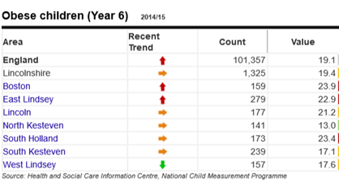
#LincsSchoolsStandUp

Slide 8
#LincsSchoolsStandUp
Solutions

Slide 9
#LincsSchoolsStandUp
Help children follow the UK Chief Medical Officers’ Guidelines.

Slide 10
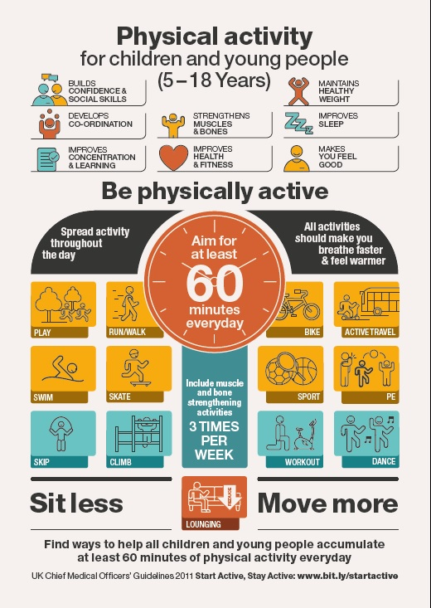

Slide 11
#LincsSchoolsStandUp
Solutions

Slide 12
The Obesity Strategy.
Soft drinks levy
20% of sugar out of products
Healthier products
Updating nutrient profiles & food labelling
Healthy options in public sector
Supporting the cost of healthy food
One hour physical activity per day
Co-ordinated sport and physical activity programmes
Healthy ratings for primary schools
Healthier school food
Supporting early years
Harnessing new technology
Health professionals supporting families

Slide 13
#LincsSchoolsStandUp
Solutions

Slide 14
#LincsSchoolsStandUp
#LincsSchoolsStandUp challenge on 23rd June 2017

Slide 15
#LincsSchoolsStandUp
All teaching staff to plan and deliver innovative ‘active lessons’ throughout the day.
Primary Schools to deliver a minimum of one active lesson during the day for each class.
Each active lesson must involve students on their feet for at least 50% of their lesson time.
Incorporate ‘active breaks’ to break up sustained periods of sitting.
Schools encouraged to hold a ‘Standing Assembly’ during the day, highlighting the need for young people to stay active and reduce time spent sitting down.
Any staff meetings that day to possibly become ‘Standing Meetings’ where possible.
Schools to promote ‘Active Travel’ to parents leading up to the event.

Slide 16
#LincsSchoolsStandUp
How to get involved?

Slide 17
#LincsSchoolsStandUp
Before the day;
Contact Rupert Gibson prior to 23rd June 2017 via agilitassports@gmail.com to register your school.
You’ll be added to a Google Drive to start sharing & receiving resources.

Slide 18
#LincsSchoolsStandUp
On the day;
Throughout the school day, staff and students are encouraged to take photographs and videos* to post on Twitter using the hash tag - #LincsSchoolsStandUp.
*Please ensure all necessary photo consent is obtained before any photo/film is shared.

Slide 19
#LincsSchoolsStandUp
After the day;
Teachers are asked to PLEDGE to deliver at least 3 active classroom lessons per week.
Keep sending in your brilliant ideas so we can keep sharing for #LincsSchoolsStandUp 2018!

